Slide 1
Doing Data Science
Unit- I
Chapter 1

Slide 2
What is Data Science?
Big Data and Data Science Hype
Getting Past the Hype / Why Now?
Datafication
The Current Landscape (with a Little History)
Data Science Jobs
A Data Science Profile
Thought Experiment: Meta-Definition
OK, So What Is a Data Scientist, Really?
In Academia
In Industry

Slide 3
Big Data and Data Science Hype
Big Data, how big?
Data Science, who is doing it?
Academia have been doing this for years
Statisticians have been doing this work.
Conclusion: The terms have lost their basic meaning and now are too ambiguous, thus, today they are now meaningless.

Slide 4
Getting Past the Hype / Why Now
The Hype: Understanding the cultural phenomenon of data science and how others were experiencing it. Study how companies, and universities are “doing data science”.
Why Now: Technology makes this possible: infrastructure for large-scale data processing, increased memory, and bandwidth, as well as a cultural acceptance of technology in the fabric of our lives. This wasn't true a decade ago.
Consideration should be to the ethical and technical responsibilities for the people responsible for the process.

Slide 5
Datafication
Definition: A process of "taking all aspects of life and turning them into data:'
For Example:
"Google's augmented-reality glasses “datafy” the gaze.
Twitter “datafies” stray thoughts.
Linkedin “datafies” professional networks:'

Slide 6
Current Landscape of Data Science
Drew Conway's Venn diagram of data science from 20l0,
Math and Statistics
Machine
Learning
Hacking Skills
Data
Science
Danger Zone
Traditional Research
Substantive
Expertise

Slide 7
Data Science Jobs
Job descriptions:
experts in computer science,
statistics,
communication,
data visualization, and to have
extensive domain expertise.
Observation: Nobody is an expert in everything, which is why it makes more sense to create teams of people who have different profiles and different expertise-together, as a team, they can specialize in all those things.

Slide 8
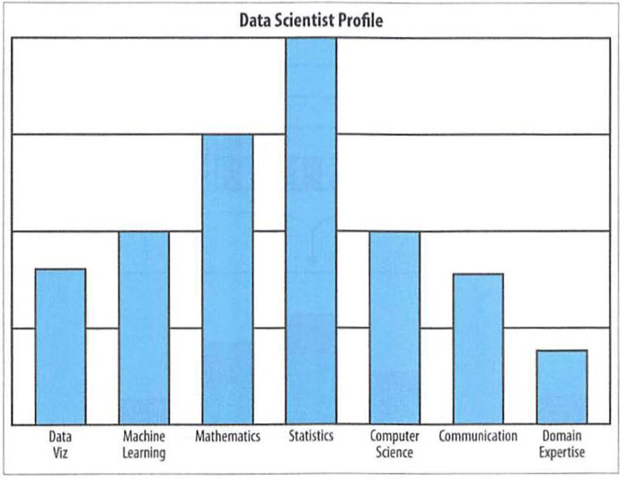
Data Science Profile

Slide 9
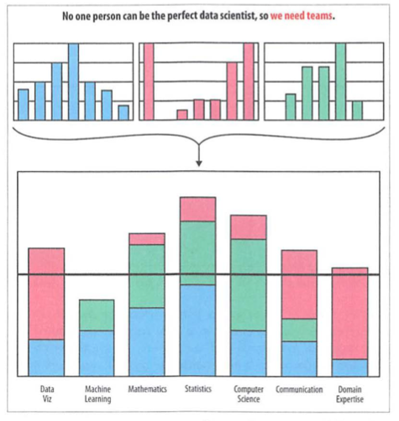
Data Science Team

Slide 10
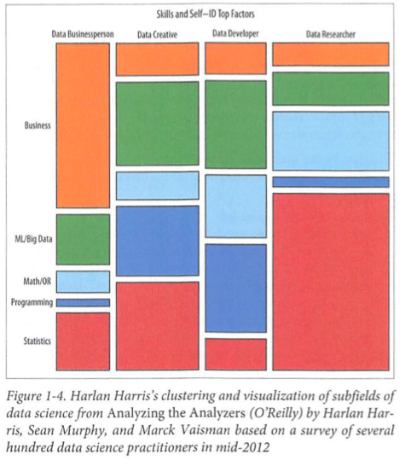

Slide 11
What is Data Science, Really?
In Academia: an academic data scientist is a scientist, trained in anything from social science to biology, who works with large amounts of data, and must grapple with computational problems posed by the structure, size, messiness, and the complexity and nature of the data, while simultaneously solving a real-world problem.
In Industry: Someone who knows how to extract meaning from and interpret data, which requires both tools and methods from statistics and machine learning, as well as being human. She spends a lot of time in the process of collecting, cleaning, and “munging” data, because data is never clean. This process requires persistence, statistics, and software engineering skills-skills that are also necessary for understanding biases in the data, and for debugging logging output from code.

Slide 12
Statistical Inference, Exploratory
Data Analysis, and the Data
Science Process
Unit-1
Chapter 2

Slide 13
Statistical thinking in the Age of Big Data
Statistical Inference
Populations and Samples
Big Data Examples
Big Assumptions due to Big Data
Modeling

Slide 14
Statistical Thinking – Age of Big Data
Prequisites – massive skills!! (Pages 14 -16)
Math/Comp Sci: stats, linear algebra, coding.
Analytical: Data preparation, modeling, visualization, communication.

Slide 15
Statistical Inference
The World – complex, random, uncertain.
Data are small traces of real-world processes.
Note: two forms of randomness exist:
Underlying the process (system property)
Collection methods (human errors)
Need a solid method to extract meaning and information from random, dubious data.
This is Statistical Inference!
Notes:
15

Slide 16
Big Data Domain - Sampling
Scientific Validity Issues with “Big Data” populations and samples. (Engineering problems + Bias)
Incompleteness Assumptions
All statistics and analyses must assume that samples do not represent the population and therefore scientifically-tenable conclusions cannot be drawn.
i.e. It’s a guess at best. These types of assertions will stand-up better against academic/scientific scrutiny.

Slide 17
Big Data Domain - Assumptions
Other Bad or Wrong Assumptions
N = 1 vs. N = ALL (multiple layers)
Big Data introduces a 2nd degree to the data context.
There are infinite levels of depth and breadth in the data.
Individuals become populations. Populations become populations of populations – to the n^{th} degree. (meta-data)
My Example:
1 billion Facebook posts (one from each user) vs. 1 billion Facebook posts from one unique user.
1 billion tweets vs. 1 billion images from one unique user.
Danger: Drawing conclusions from incomplete populations. Understand the boundaries/context.

Slide 18
Modeling
What’s a model?
An attempt to understand the population of interest and represent that in a compact form which can be used to experiment/analyze/study and determine cause-and-effect and similar relationships amongst the variables under study IN THE POPULATION.
Data model
Statistical model – fitting?
Mathematical model

Slide 19
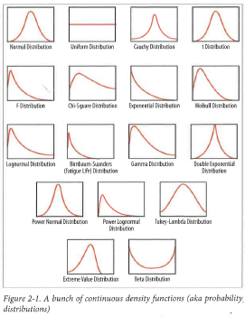
Probability Distributions

Slide 20
Exploratory Data Analysis (EDT)
“It is an attitude, a state of flexibility, a willingness to look for those things that we believe are not there, as well as those we believe to be there.” John Tukey
Traditionally presented as a bunch of histograms and stem-and-leaf plots.

Slide 21
Features
EDT is a critical part of data science process.
Represents a philosophy or way of doing statistics.
No hypotheses and there is no model.
“Exploratory” aspect means that your understanding of the problem you are solving, or might solve, is changing as you go.

Slide 22
Basic Tools of EDA
Plots, graphs and summary statistics.
Method of systematically going through the data, plotting distributions of all variables.
EDA is a set of tools, it’s also a mindset.
Mindset is about relationship with the data.

Slide 23
Philosophy of EDA
Many reasons any one working with data should do EDA.
EDA helps with de-bugging the logging process.
EDA helps assuring the product is performing as intended.
EDA is done toward the beginning of the analysis.

Slide 24
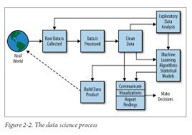
Data Science Process

Slide 25
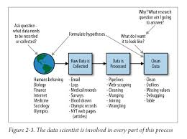
A Data Scientist’s Role in This process

Slide 26
Algorithms
Unit- II
Chapter 3

Slide 27
What is an algorithm?
Series of steps or rules to accomplish a tasks such as:
Sorting
Searching
Graph-based computational problems
Because one problem could be solved by several algorithms, the “best” is the one that can do it with most efficiency and least computational time.

Slide 28
Three Categories of Algorithms
Data munging, preparation, and processing
Sorting, MapReduce, Pregel
Considered data engineering
Optimization
Parameter estimation
Newton’s Method, least squares
Machine learning
Predict, classify, cluster

Slide 29
Data Scientists
Good data scientists use both statistical modeling and machine learning algorithms.
Statisticians:
Want to apply parameters to real world scenarios.
Provide confidence intervals and have uncertainty in these.
Make explicit assumptions about data generation.
Software engineers:
Want to create production code into a model without interpret parameters.
Machine learning algorithms don’t have notions of uncertainty.
Don’t make assumptions of probability distribution – implicit.

Slide 30
Linear Regression (supervised)
Determine if there is causation and build a model if we think so.
Does X (explanatory var) cause Y (response var)?
Assumptions:
Quantitative variables
Linear form

Slide 31
Linear Regression (supervised)
Steps:
Create a scatterplot of data
Ensure that data looks linear (maybe apply transformation?)
Find “line of least squares” or fit line.
This is the line that has the lowest sum of all of the residuals (actual values – expected values)
Check your model for “goodness” with R-squared, p-values, etc.
Apply your model within reason.

Slide 32
k-Nearest Neighbor/k-NN (supervised)
Used when you have many objects that are classified into categories but have some unclassified objects (e.g. movie ratings).
Assumptions:
Data is of the type where “distance” make sense.
Training data is in two or more classes.
Observed features and the labels are associated (not necessarily).
You pick k.

Slide 33
k-Nearest Neighbor/k-NN (supervised)
Pick a k value (usually a low odd number, but up to you to pick).
Find the closest number of k points to the unclassified point (using various distance measurement techniques).
Assign the new point to the class where the majority of closest points lie.
Run algorithm again and again using different k’s.

Slide 34
k-means (unsupervised)
Goal is to segment data into clusters or strata
Important for marketing research where you need to determine your sample space.
Assumptions:
Labels are not known.
You pick k (more of an art than a science).

Slide 35
k-means (unsupervised)
Randomly pick k centroids (centers of data) and place them near “clusters” of data.
Assign each data point to a centroid.
Move the centroids to the average location of the data points assigned to it.
Repeat the previous two steps until the data point assignments don’t change.

